Slide 1
Writing your hypothes.is: Collaborative annotation in the classroom
Dr. Rachel Schneider, Missouri S&T
@r_schneide

Slide 7
Imagine that you enter a parlor. You come late. When you arrive, others have long preceded you, and they are engaged in a heated discussion, a discussion too heated for them to pause and tell you exactly what it is about. In fact, the discussion had already begun long before any of them got there, so that no one present is qualified to retrace for you all the steps that had gone before. You listen for a while, until you decide that you have caught the tenor of the argument; then you put in your oar. Someone answers; you answer him; another comes to your defense; another aligns himself against you, to either the embarrassment or gratification of your opponent, depending upon the quality of your ally's assistance. However, the discussion is interminable. The hour grows late, you must depart. And you do depart, with the discussion still vigorously in progress.
Kenneth Burke, The Philosophy of Literary Form (1967)

Slide 8
Technologies for Collaborative Annotation
Genius – Web Annotator
Diigo
Google Docs
Hypothes.is

Slide 9
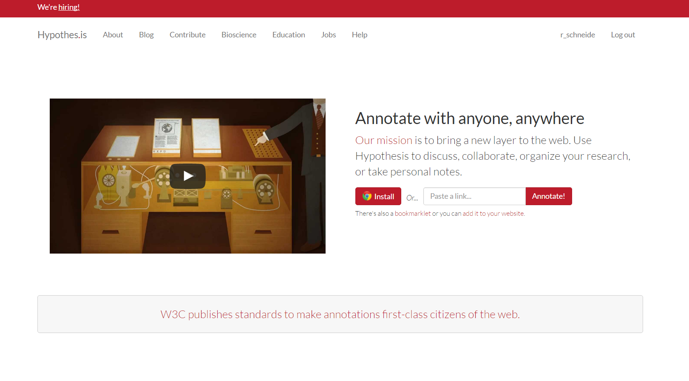

Slide 11
Assignment Description
During the eighteenth-century, reading was a far more communal activity. Texts were also more expensive relative to income and harder to get, so readers used different ways to share material: for instance, a gentleman might go to the coffee house to read the newspaper, where one copy might be shared among 20 different men (at least, so the Spectator speculates). Readers might subscribe to a circulating library, where they would have to wait for each individual volume of a novel. Finally, friends might share one copy of a novel between themselves, where each might make notes in the margins for the other to read. This marginalia was one way readers had of sharing their interpretations with each other, especially over distances.
Today, we have different ways of writing marginalia, especially when our texts no longer have margins. Comments at the bottom of a newspaper article allow us to engage in that coffee-house conversation in an online forum; readers with Kindles can see which passages from their book are the most frequently highlighted.
Your experiment for this final reading lab is to practice this art of marginalia on eighteenth-century texts, though in a digital format. Using the web annotation platform hypothes.is (Links to an external site.), you will read your texts and annotate them as you read, responding to each others’ marginalia as well.
Marginalia can be loosely divided into several categories: (1) informational, where you add context to the reading with outside information: defining terms, including key facts, or adding historical context; (2) interpretive, where you argue for a significant moment in the text: highlighting a word, say, and explaining how it’s significant in the larger piece; (3) reactive, where you record how the passage made you feel, or what struck you as exciting or interesting in it. Reactive annotations online might include linking to a picture that connects to your experience with the reading. (Hypothes.is also has a guide for student annotations (Links to an external site.), which I strongly encourage you to check out.)
For this assignment, you will need to annotate in all three ways, at least once. (So: there are multiple readings, but you only need to leave three comments total.) You must also have one of your marginal notations respond to someone else’s: so, if someone has a question, you can respond with information. If someone has a reaction, you can react in return. You can challenge someone’s interpretation, or discuss a second passage that responds to their reading. The idea is to replicate that experience of discussing a text in the margins.
Your procedure for this lab will be to first sign up for a hypothes.is account and install the Chrome extension for it. A slideshow that explains how to do this is here (Links to an external site.). You will then want to make sure that your annotations show up in our class group; to annotate as a member of our class group, you will need to go to this link to find our class documents (Links to an external site.). (Hypothes.is also has a guide for commenting in groups (Links to an external site.).)
Once you have hypothes.is set up, you can visit the webpages linked from the module which contain our readings for Wednesday’s class. You will need to complete your annotations before class on Wednesday, though your write-up is officially due on Friday. Your lab report should focus mostly on your results/conclusions section, where you describe the experience of annotating and reading others’ annotations, and evaluate how that impacted your reading experience of the texts. However, your methodology section should focus on how you decided what to annotate; where you found additional information, if any.

Slide 12
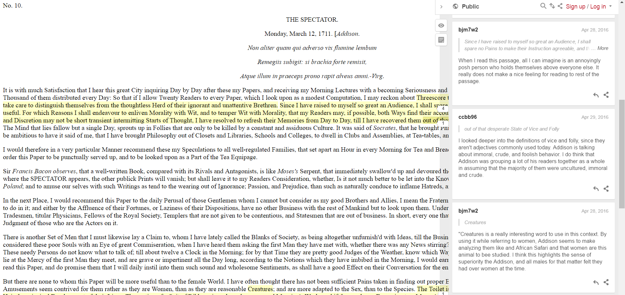

Slide 14
Student Responses
“The annotation software added to the understanding of the texts and to the context in which they were written. It was helpful for multiple people to read the same literary works and provide insight to areas they found interesting. For example, I researched a scientific hypothesis presented and commented about the truth of the claim. Others researched different thoughts and topics and provided insight into those areas. This collaboration was rather helpful. Instead of researching everything of interest, I only had to look into just a few things, which saved time. It was also time saving to ask the group questions instead of researching online. The group collaboration also expanded knowledge on things I didn’t even think about. Even though the reading was online, there was a strong human element to this exercise, as it was comforting to know whom I am conversing with.”

Slide 15
Student Responses
“While reading through the texts I found it difficult at first to find a section of the text that I wanted to annotate because I wanted to find something unique to discuss. At first it seemed that many of the ‘good’ sections had been combed over, but it just made me dig a little deeper into what was going on with in the text and I was able to find some interesting things hiding in the text. For instance had I not had to look further into the third document I probably wouldn’t have given the name of a ship a second thought, but because I did I learned that while the ship in the document may have been fictional there have been several ships within the Royal Navy that share the same name. I also would not have dug as deep into the characters reasoning for remaining reserved but because I did I was able to make several connection with in the first document. Over all I feel like reading documents in this environment like this help me to better understand what is taking place behind the face value of the text because it stimulates questions about the documents.”

Slide 16
Annotating Scholarly Writing

Slide 17
Annotating Sample Papers in Google Docs

Slide 18
Peer Reviews with GIFs

